Slide 1
Real-time Data Processing
Team Member
Hua
Kiru
Sai
Zaw 24-Sep-2024
10:00 AM

Slide 2
Agenda
System Design
Our data source
How we fetch and produce data into Kafka
How we store data into HBase
How we plan to use Spark SQL
How we sync data for visualization
Demo
Cloud Demo

Slide 3











System Design
Real
Time
Financial Modeling Prep API

Slide 4
System Design - Versioning
Zookeeper 3.4.14
Kafka 2.11_2.4.1
Spark 1.6.0
Spark SQL 2.11
Hbase 1.2.0
Java 8
Logstash 7.13.4
Elastic search 6.8.13
Kibana 6.8.13
Elastic Cloud

Slide 5
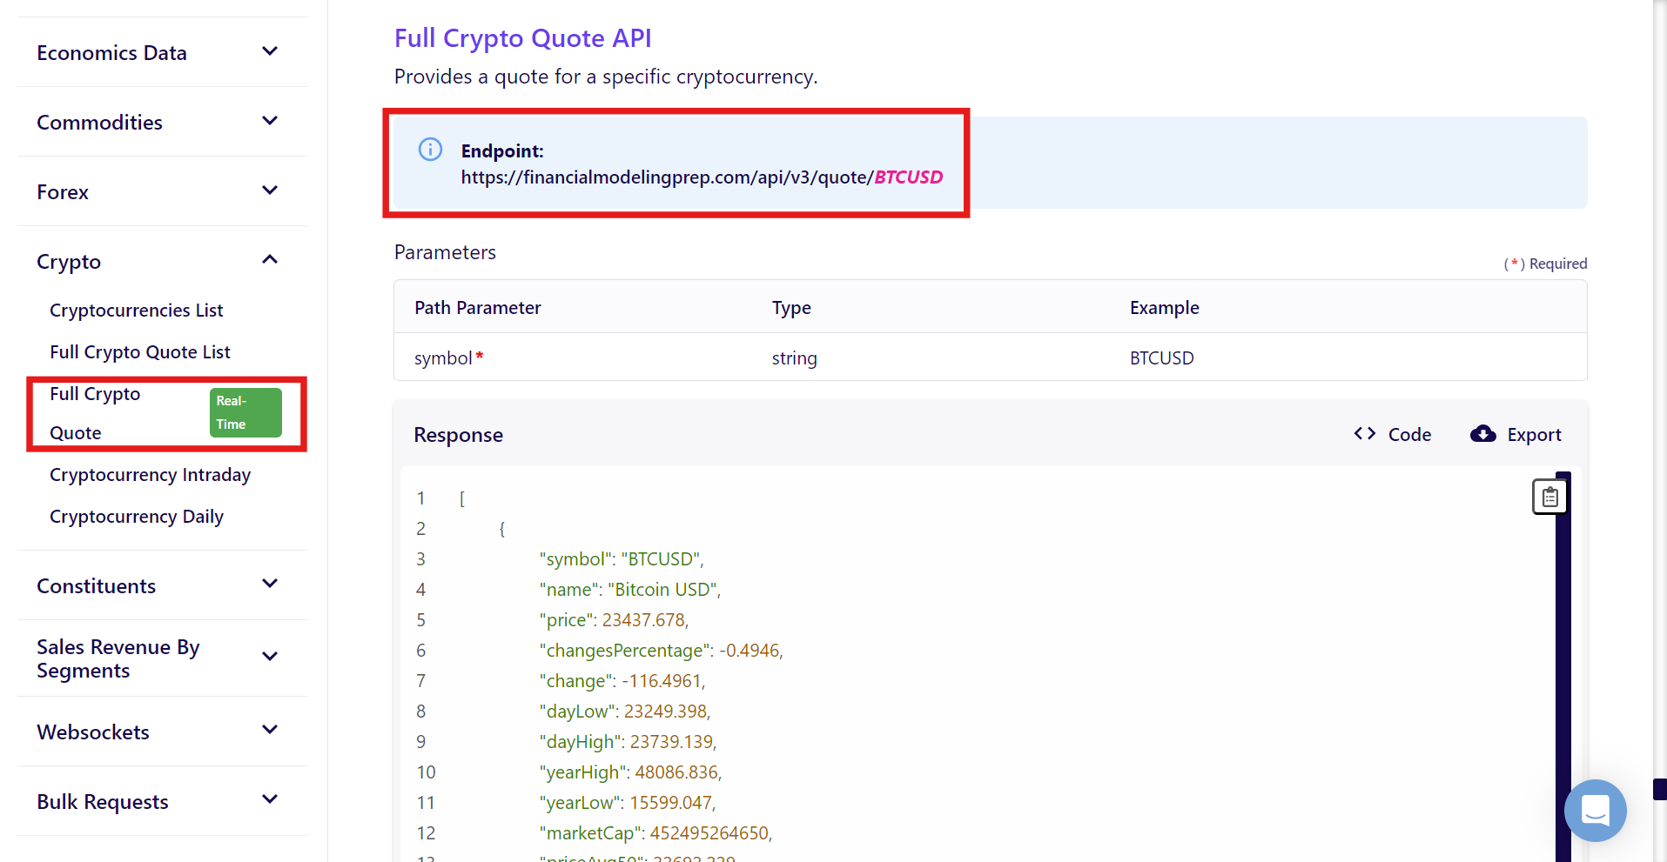
Data source
Financial Modeling Prep API

Slide 6

How we fetch and produce data into Kafka
Using “connect-standalone.bat”

Slide 7
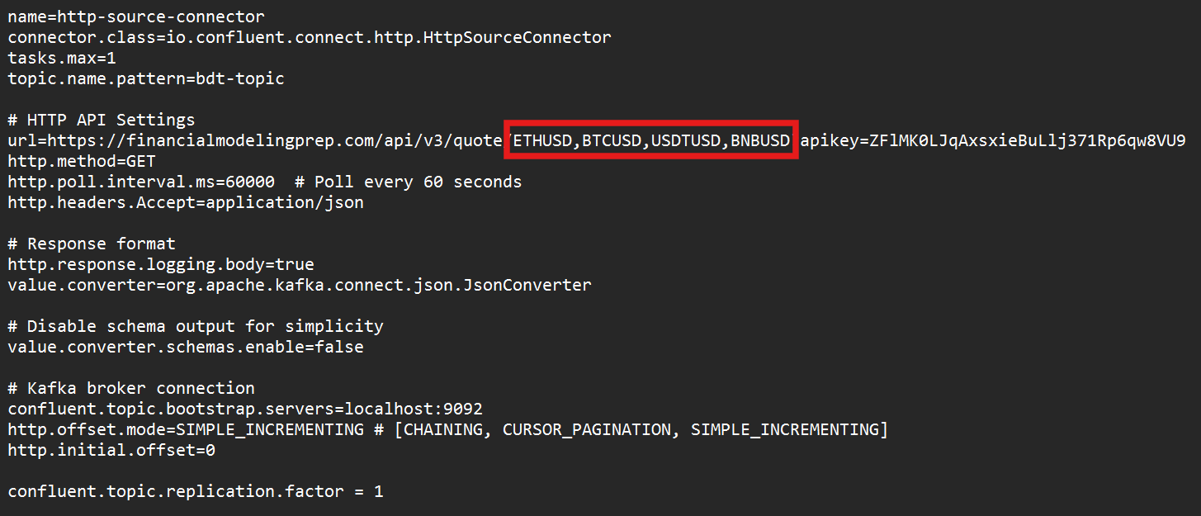
How we fetch and produce data into Kafka
/connect-standalone.bat
/config/connect-standalone.properties
/http-connector.properties
http-connector.properties

Slide 8

How we store data into HBase

Slide 9
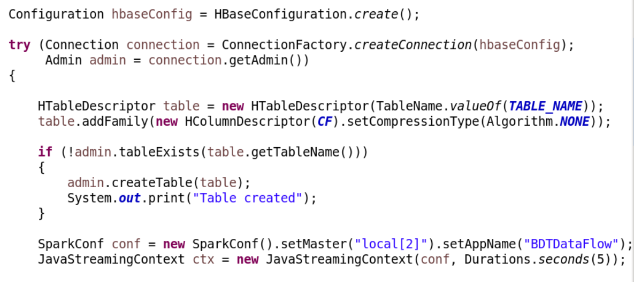
How we store data into HBase
Hbase connection and Spark Streaming context

Slide 10
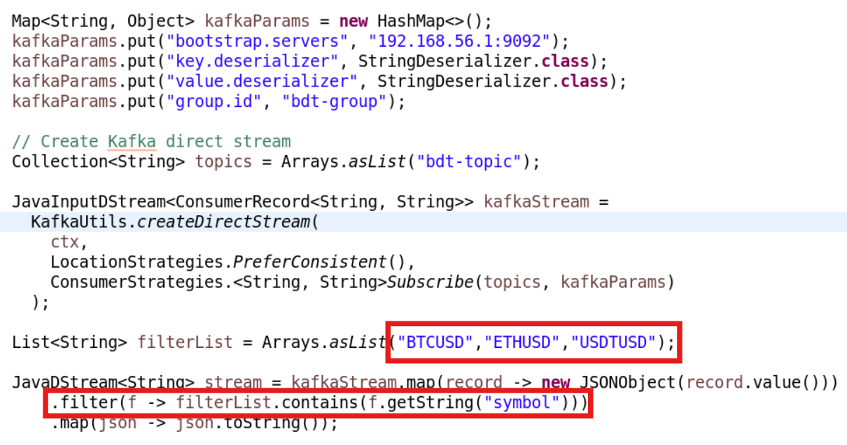
How we store data into HBase
Consuming kafka data via java

Slide 11
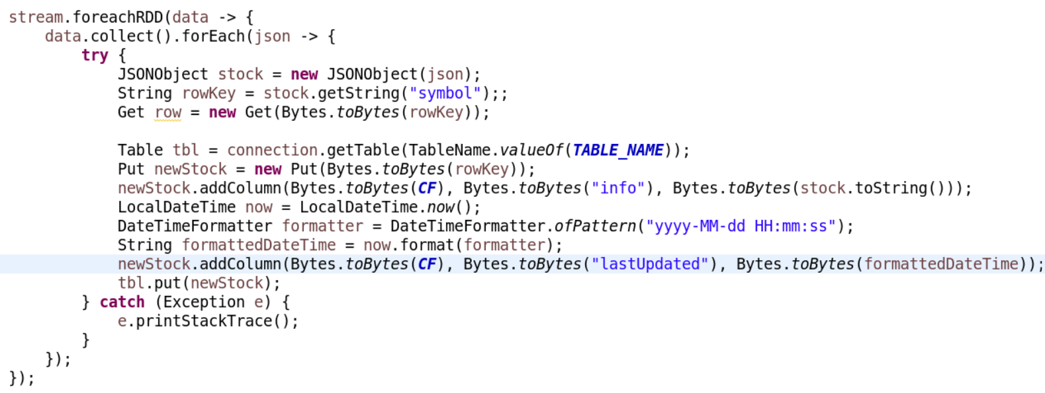
How we store data into HBase
Storing data into HBase

Slide 12
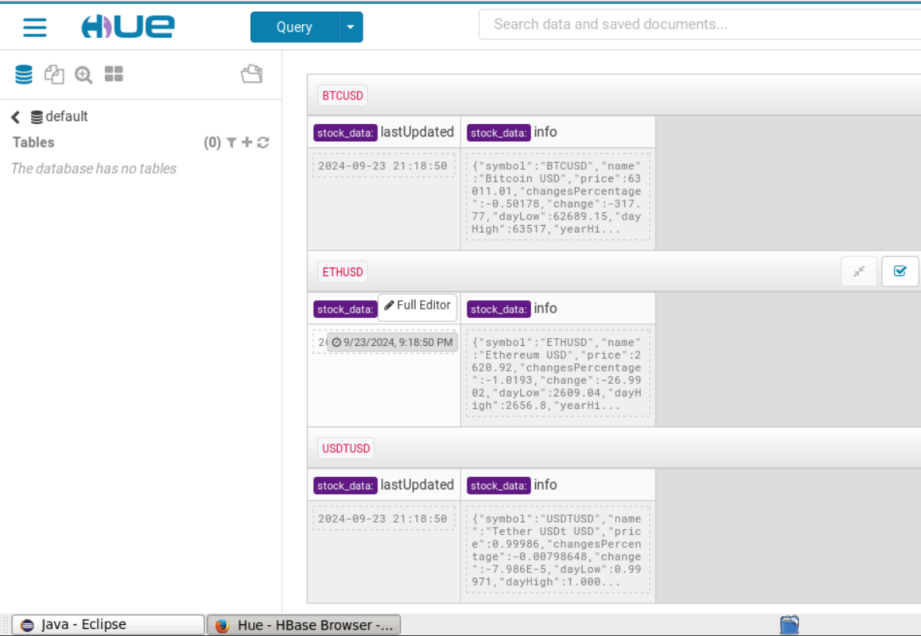
How we store data into HBase

Slide 13
How we plan to use Spark SQL
Downstream System

Slide 14
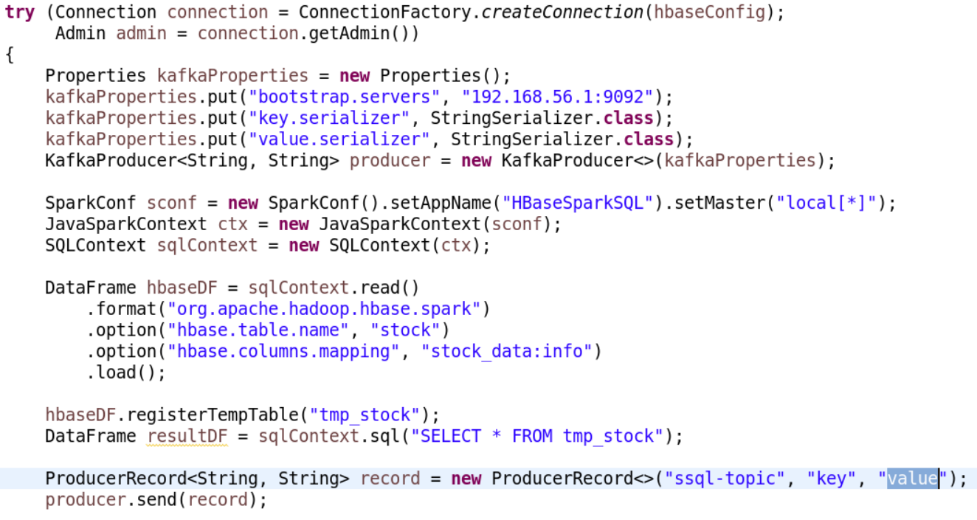
How we plan to use Spark SQL

Slide 15
How we sync data for virtualization

Slide 16
How we sync data for virtualization
\logstash.bat -f \hbase2CloudES.conf

Slide 17
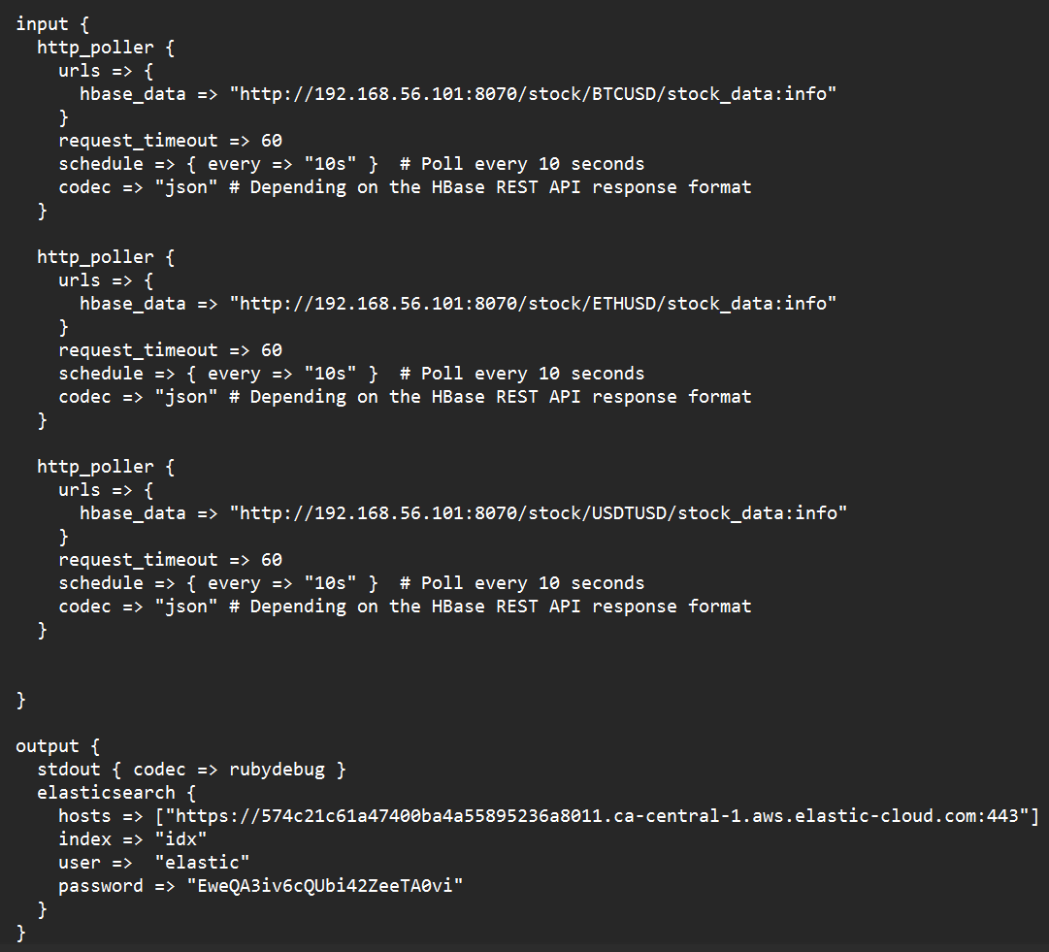
How we sync data for virtualization

Slide 18
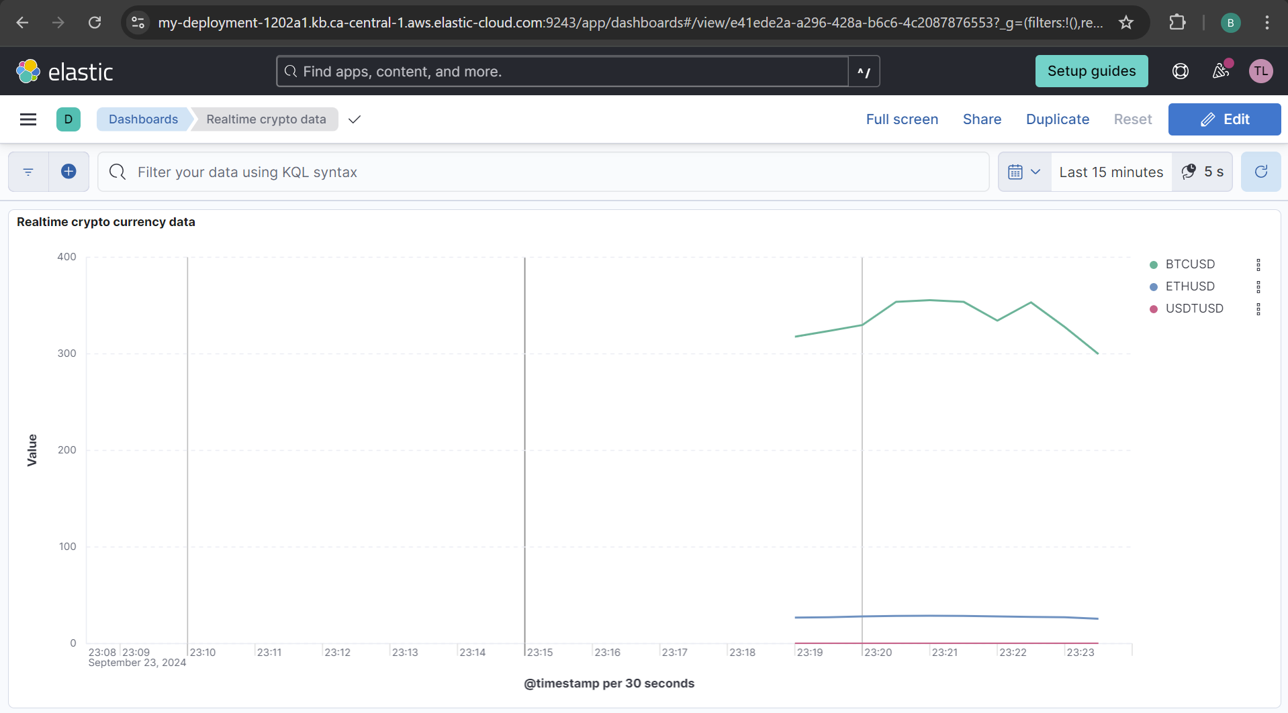

Slide 19
Demo
Start Zookeeper
Start Kafka
Run DataFlow java program
Start Logstash for cloud
Start local Elastic search when required
Start local Kibana when required
Start local Logstash when required
Start data fetch

Slide 20
Demo
Kibana Dashboard Cloud
Kibana Dashboard Local

Slide 21

Cloud
Demo

Slide 22
Thank You !

